Slide 1
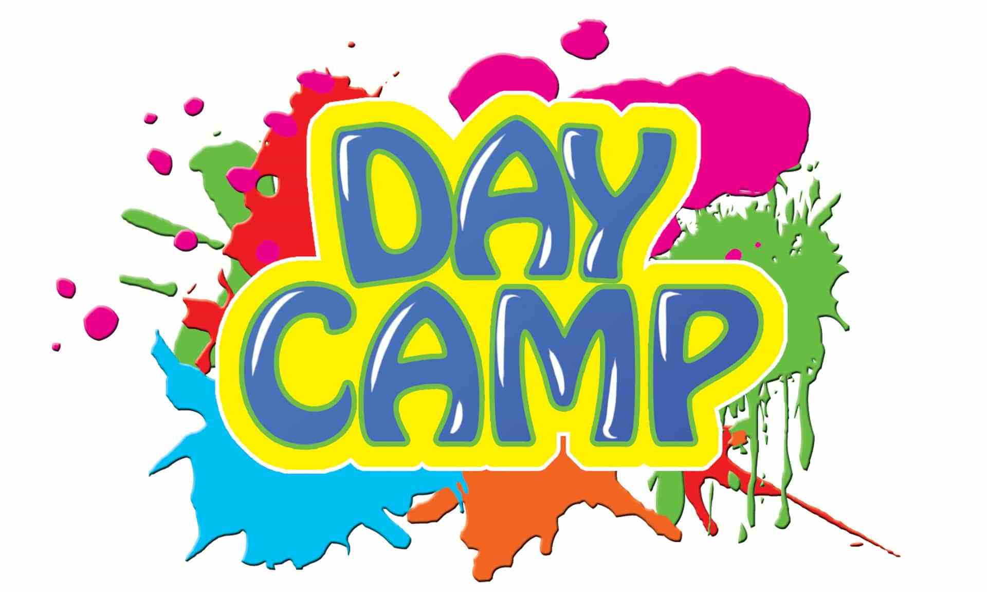
Preschool HABIT-ILE
Helping kids with CP to improve their movement and independence in daily life
Kids with cerebral palsy can find it difficult to use their two hands together to do everyday activities. They can also have trouble with their gross motor skills and how they move around. We are testing an intensive type of therapy called Hand Arm Bimanual Intensive training Including Lower Extremity Training (HABIT-ILE) delivered by physiotherapists, occupational therapists and therapy students that helps kids to improve their motor skills and independence in daily life activities.
Do you have a child aged
2 years to 5 years, 5 months old with
bilateral cerebral palsy (GMFCS II-IV) ?
Do you live in or near Brisbane, QLD?
Call or email us to find
out if your child can participate in this research study!
What are the details?
4 hours/day for 10 weekdays in groups of 4-6 kids
Play-based therapy
Delivered by a PT, OT and therapy students
1-on-1 therapy with a dedicated therapist
Personalised to your child's goals, priorities and interests
If you would like more information about this study please contact us:
QUEENSLAND and general enquiries
Dr Leanne Sakzewski
Queensland Cerebral Palsy Rehabilitation Research Centre
The University of Queensland
l.sakzewski1@uq.edu.au
07 3069 7345
Preschool HABIT-ILE V.3 17/06/2020

